Slide 1

Object Detection Using YOLO dataset
Presented by:
Rajeshwari Bhirud
Sahithi Reddy Malgari

Slide 2
Introduction
•Utilize YOLOv5 architecture for object detection tasks.
•Implement real-time object
detection using a pre-trained model.

Slide 3
Tech and libraries used
PyTorch: Utilized as the primary deep learning framework for implementing and training the YOLOv5 model.
YOLOv5: Employed for real-time object detection due to its speed and accuracy, sourced from the Ultralytics repository.
OpenCV: Used for image and video processing, enabling the integration of the YOLOv5 model with real-time webcam feeds.
Matplotlib: Utilized for visualizing the results of the object detection process, displaying bounding boxes and object labels.
NumPy: Used for numerical operations and array manipulations in various stages of the implementation.
torchvision: Applied for image transformation and dataset handling, extending PyTorch's capabilities.
GitHub: Leveraged for version control, collaboration, and sharing project resources with the open-source community.

Slide 4
Purpose of the project
The primary purpose is to implement YOLOv5 for efficient object detection, contributing to the broader field of computer vision.
To develop a small application that can be used in retail world for product analysis.
To add shopping website links to the detected objects suggesting where the product can be bought from.

Slide 5
How it works !!!!
•The code begins by installing the necessary libraries, including PyTorch and YOLOv5.
•The YOLOv5 repository is cloned from GitHub, and required dependencies are installed.
•Loading the YOLOv5 Model:
•The PyTorch hub is used to load the YOLOv5 model (yolov5s - small variant).
•The model is pre-trained on a large dataset for general object detection tasks.
.•The code demonstrates object detection on both a static image and the YOLOv5 model processes the image and prints the detected objects and their confidence scores.
•Matplotlib is employed to visualize the results, displaying bounding boxes around detected objects.
•The code also includes functionality to render results directly within the Jupyter notebook for image processing.
•The code can be extended for specific use cases, such as custom datasets or fine-tuning for specialized objects.

Slide 6
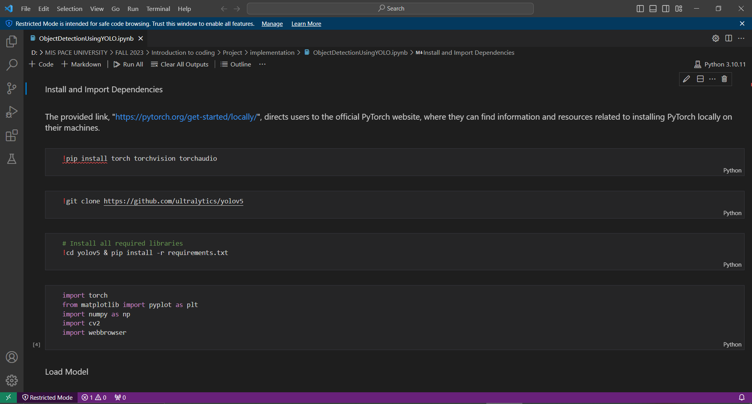

Slide 7
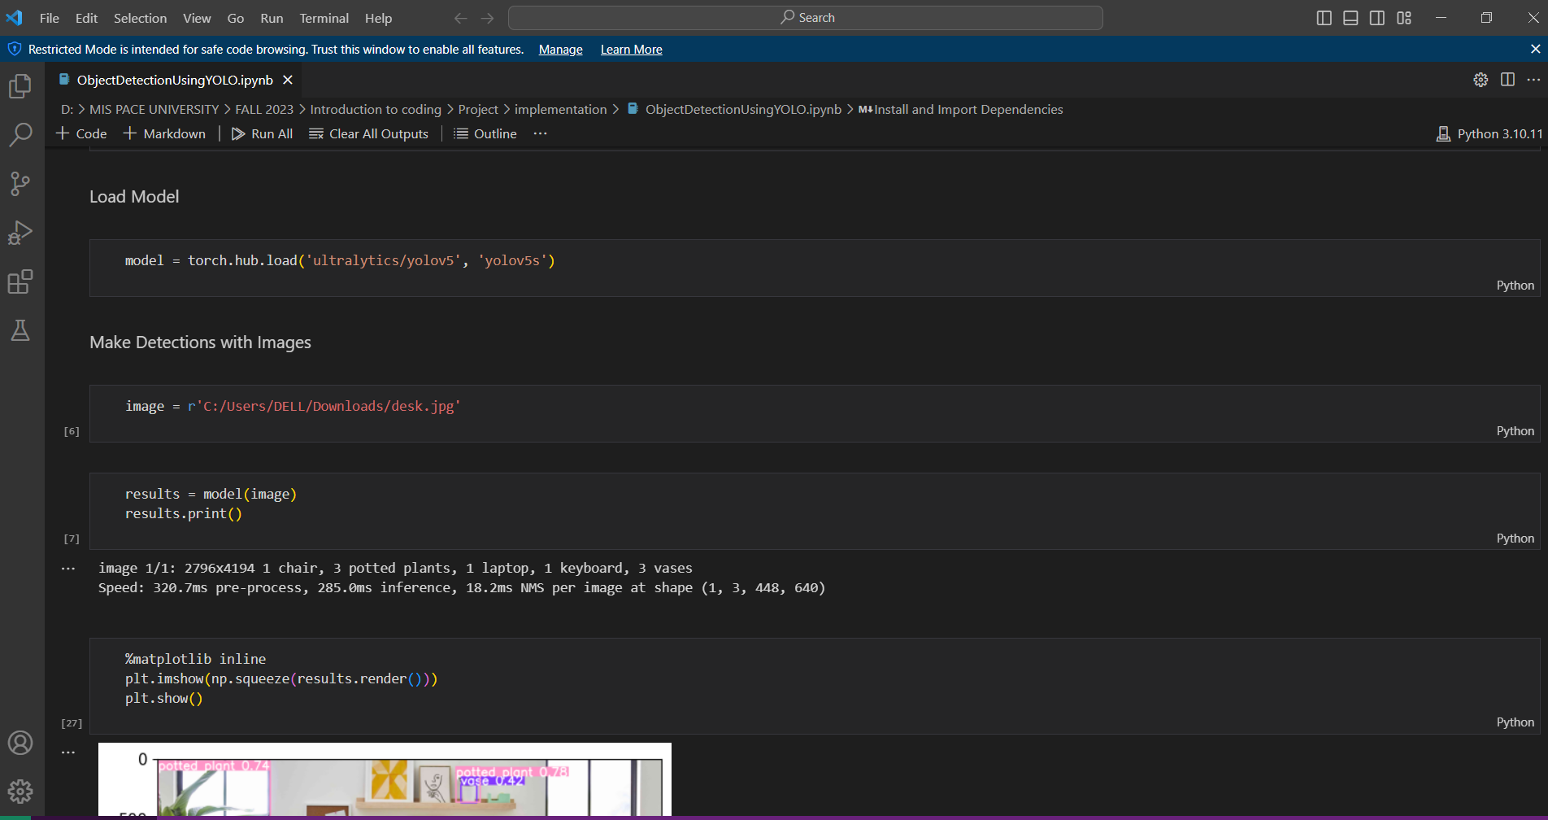

Slide 8
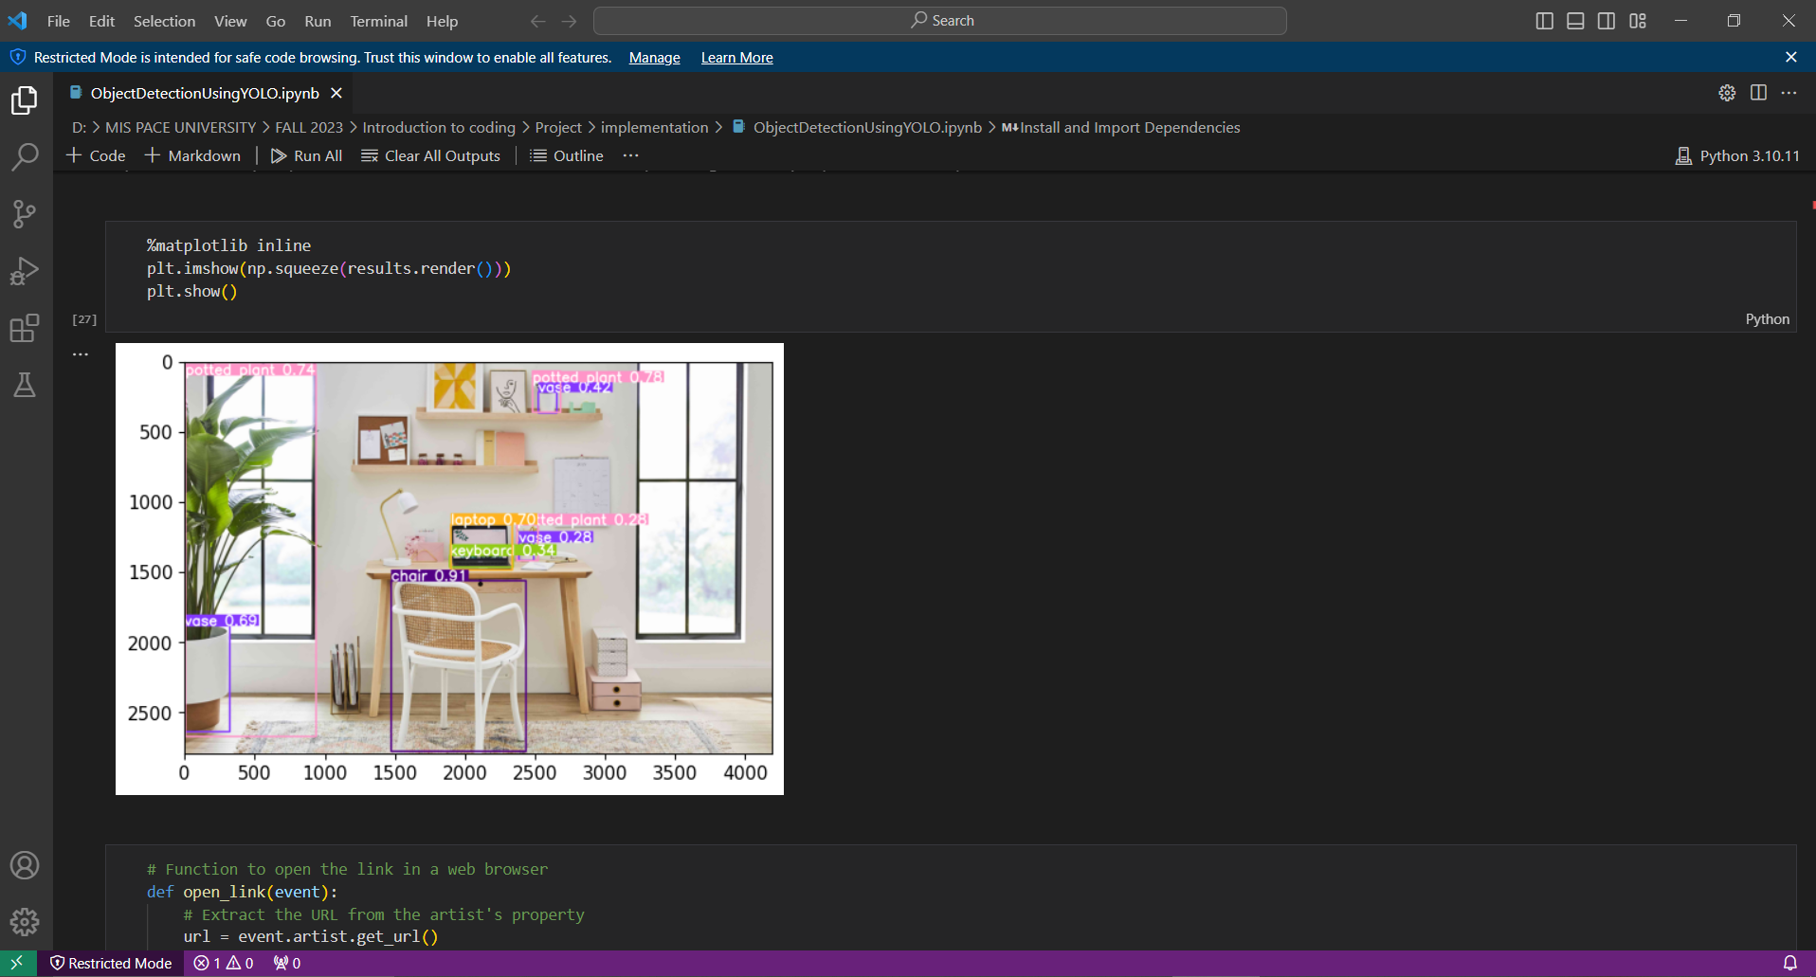

Slide 9
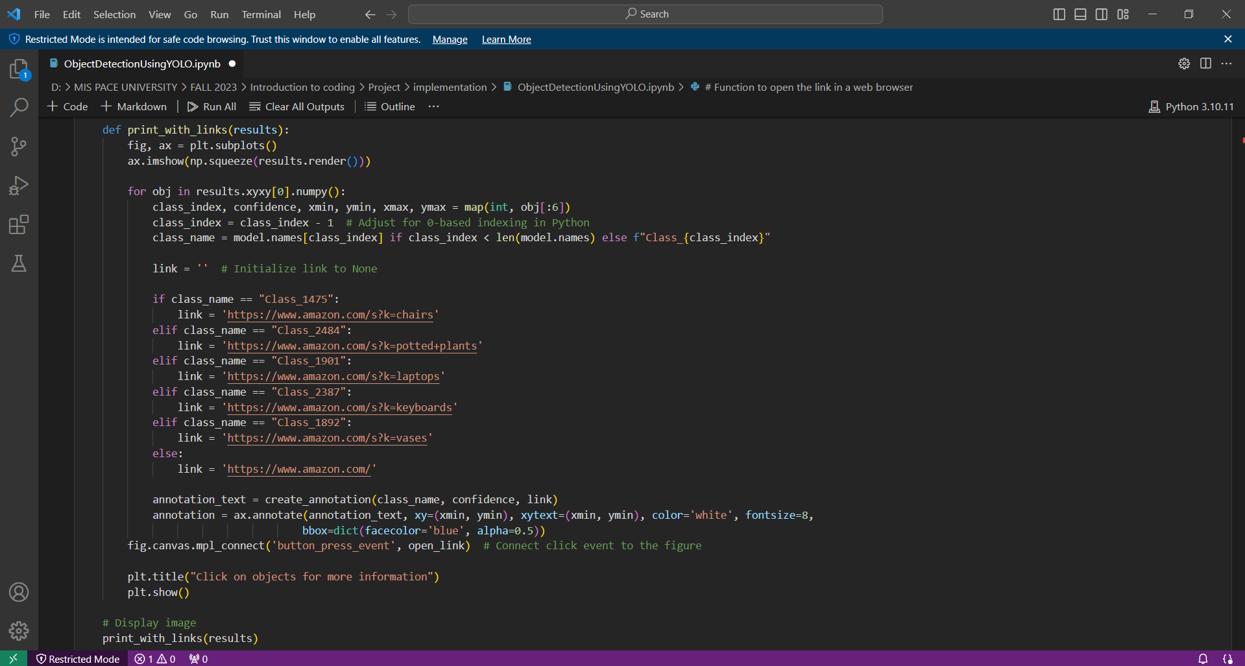

Slide 10
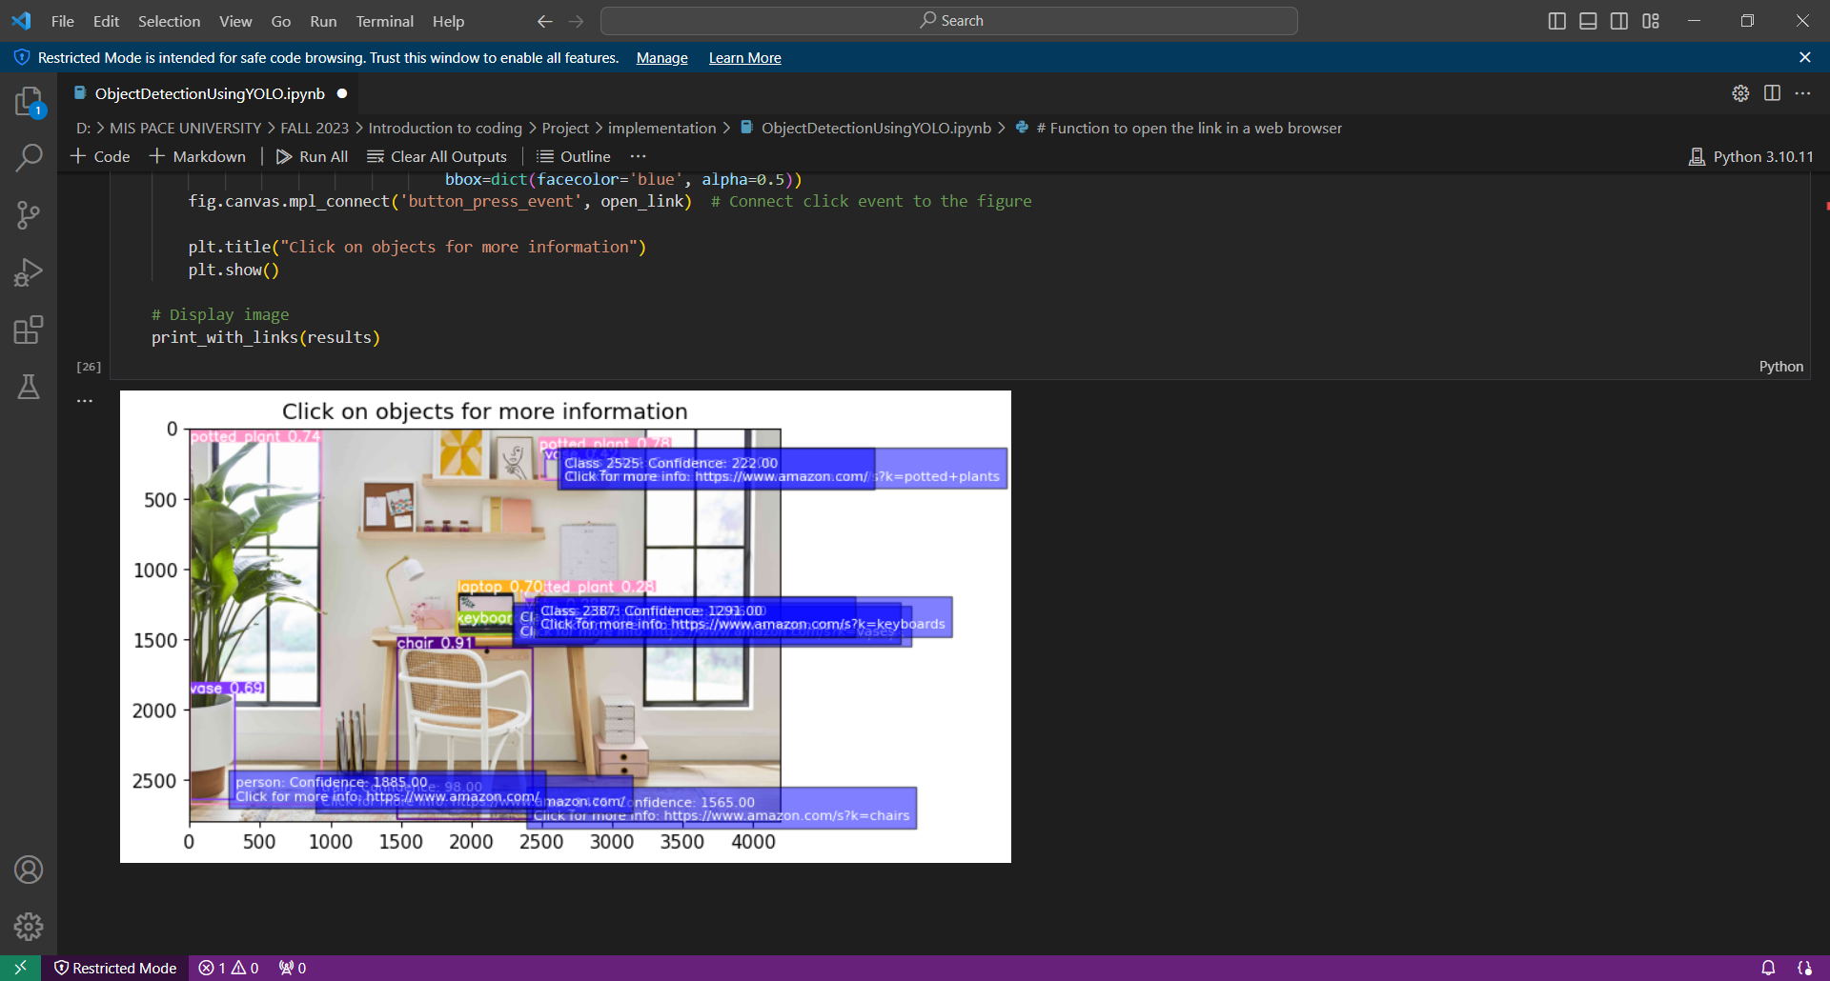

Slide 11
Advantage
Real-Time Object Detection: YOLOv5 excels in real-time object detection, making it suitable for applications requiring quick responses.
Accuracy and Versatility: YOLOv5 balances accuracy and speed, making it versatile for various object detection tasks.
Single Forward Pass: The model processes the entire image in a single forward pass, contributing to its efficiency.
Ease of Implementation: YOLOv5's implementation is straightforward, and the Ultralytics repository provides pre-trained models for easy integration.

Slide 12
Disadvantage
Limited Small Object Detection: YOLOv5 may struggle with accurately detecting small objects in images due to its coarse grid.
Training Data Dependency: The model's performance heavily depends on the quality and diversity of the training dataset.
Resource Intensive: YOLOv5, particularly larger variants, can be resource-intensive during training and may require powerful hardware.

Slide 13
Conclusion
Explore opportunities for fine-tuning the YOLOv5 model to improve performance on domain-specific datasets.
Utilize object detection to identify specific products in a customer's field of view, enabling personalized product recommendations and targeted advertising.
Develop a visual search feature that allows customers to search for products using images, leveraging object detection to identify relevant items in the retailer's catalog.
Extend the project to address more complex real-time applications, such as object tracking or multi-object tracking.

Slide 14
Thank You

